Slide 1

Alarm Clock For Heavy Sleeper
Group Members
Roll No
Name
62
Harsh Pravin Chandankhede
64
Sumedh Rupeshkumar Kamble
65
Prathmesh Rajaram Gosavi
67
Mandar Balasaheb Patil
71
Aditya Bhimrao Kamble

Slide 2

Introduction
Problem Statement
Project Aim
Heavy sleepers often miss alarms, causing oversleeping and missed commitments.
Create an alarm app requiring puzzle solving to stop the alarm.
Goal
Ensure users are mentally alert and awake before turning off alarm.

Slide 3

Objectives
Effective Wake-up
Interactive Alarm
Integrated Features
Help heavy sleepers wake up by engaging their mind.
Require solving a math puzzle to deactivate alarm.
Use real-time clock, alarm scheduling, audio, and UI components.

Slide 4
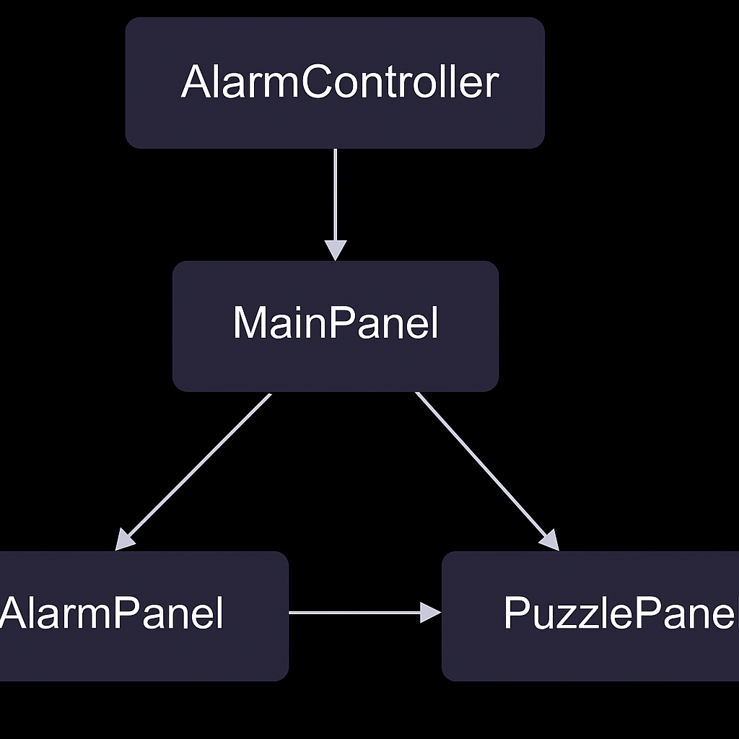
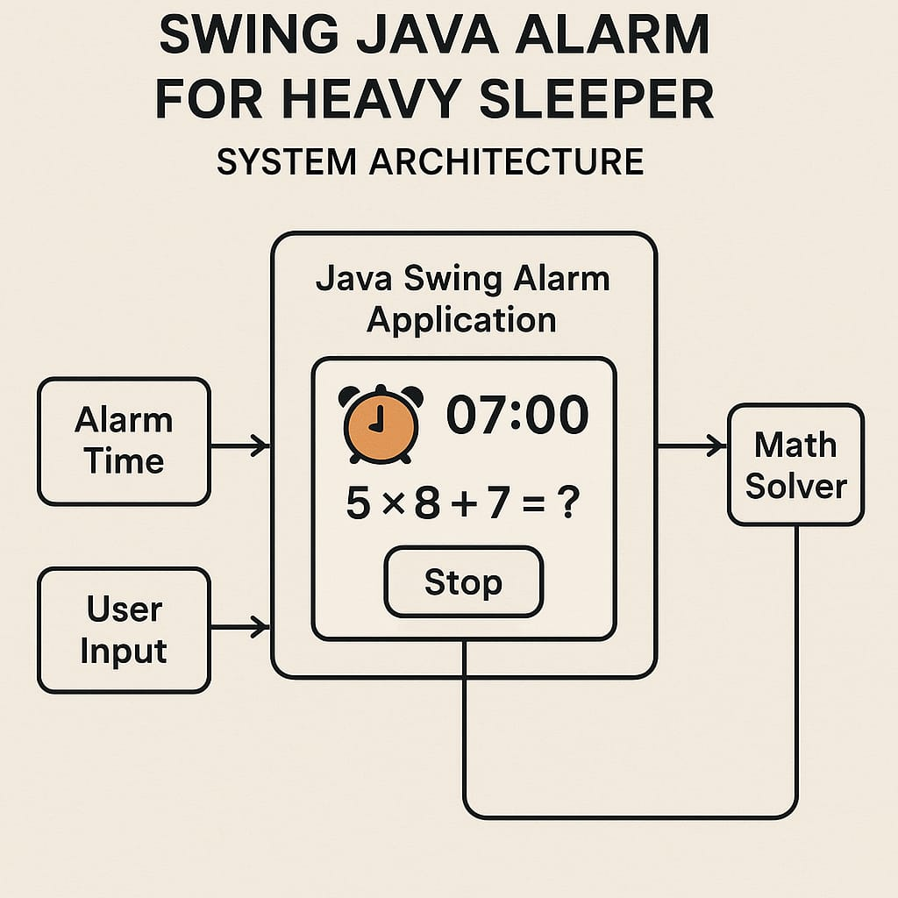
System Architecture
AlarmPanel
Set alarm time and display current system time in real-time.
PuzzlePanel
Show math puzzle to stop alarm sound when triggered.
AlarmController
Manage alarm logic, sound playback, and puzzle generation.
MainPanel
Switch between AlarmPanel and PuzzlePanel using CardLayout.

Slide 5

Working of the System
Alarm Setting
User inputs alarm time; system shows current and set time.
Alarm Trigger
AlarmController checks time and triggers alarm sound.
Puzzle Verification
User solves math puzzle to stop alarm sound.
Navigation
MainPanel switches views based on alarm state.

Slide 6

Java Concepts Used
Java Swing
CardLayout
Used for building the desktop application's graphical user interface.
Manages switching between alarm and puzzle panels.
Event Handling
Multithreading
Handles user inputs and alarm triggers effectively.
Ensures real-time clock updates and alarm checks run smoothly.

